Slide 1
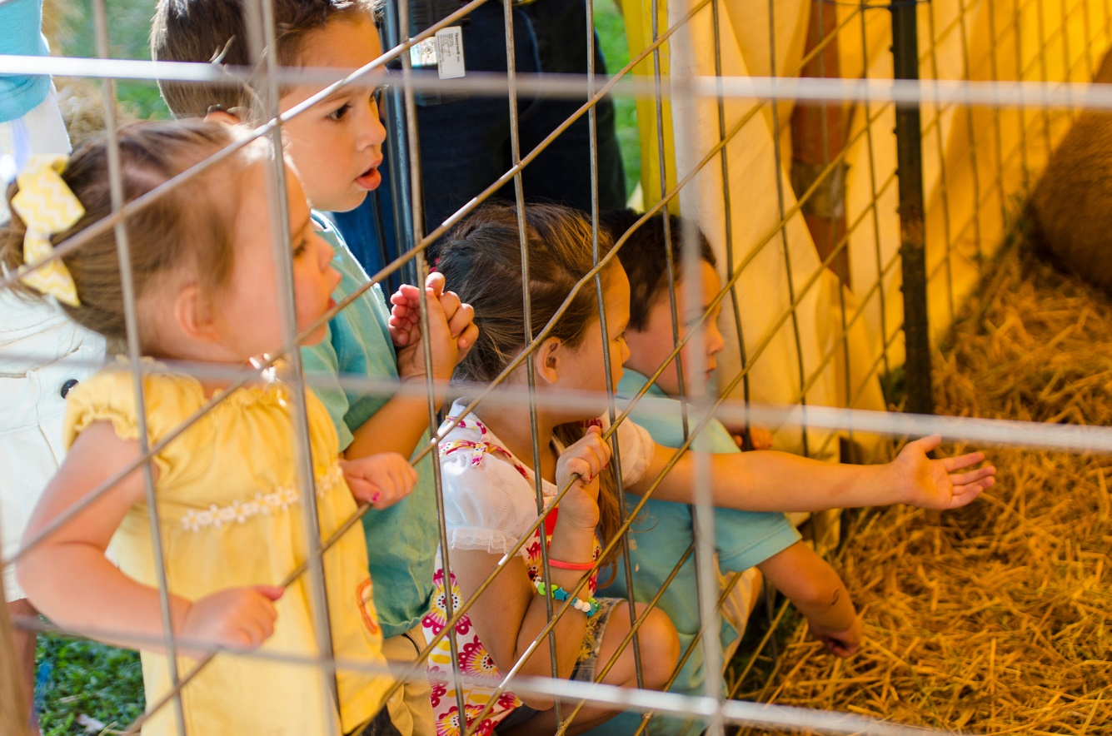
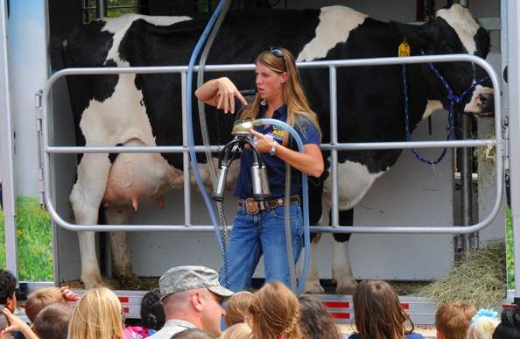
Agritourism and Fairs
Animal and Public Health Education

Slide 2
What is Agritourism?
Any agricultural-related activity that brings visitors to a farm
Examples include:
Working farm with petting zoo
Farm tours
“Goat yoga”
Pick-Your-Own
Winery tours & tastings
Corn maze
Notes:
Wine tasting, pumpkin patch, hayrides and more!

Slide 3
Why Agritourism?
Farmers can market their products directly to consumers
Can be more profitable than selling to retail or other indirect means
Consumers value on-farm experiences
Family activity
Educational opportunity
Confidence in “buying local”
A rapidly growing trend in the Northeast!

Slide 4
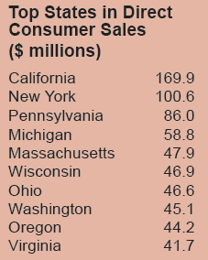
Agritourism: A Growing Trend
State | Farms in 2007 | Farms in 2012 | % Increase
MA | 154 | 287 | 86%
CT | 101 | 237 | 135%
RI | 43 | 68 | 58%
NH | 88 | 190 | 116%
VT | 109 | 155 | 42%
ME | 112 | 270 | 141%
135%
116%
141%
Farmers Marketing. 2012 Census of Agriculture, Highlights. USDA NASS.

Slide 5
Fairs – Role in Agritourism
Also provide that public-livestock interaction
Allows for similar opportunities for public education and interaction with food origins and farming in general
Poses similar health risks to naïve public

Slide 6
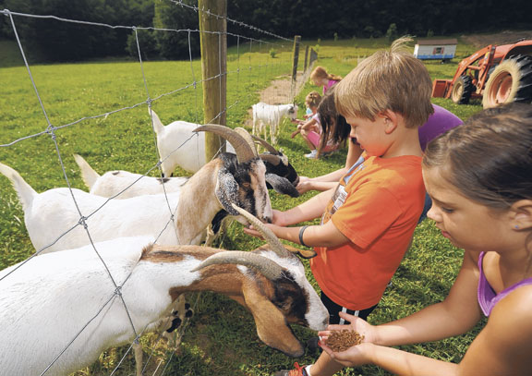
Challenges with Agritourism
Farmers want to offer true picture of agriculture and farm-fresh products
However, also inviting risk
Lack of public understanding of a “working farm”
Farm equipment, animal behaviors, etc.
Public can bring disease to the farm
Exposure of visitors to potential pathogens on the farm
Through animal contact or food served on-farm
E. coli, Salmonella, Campylobacter, Orf, Rabies, Ringworm, parasites, etc.

Slide 7
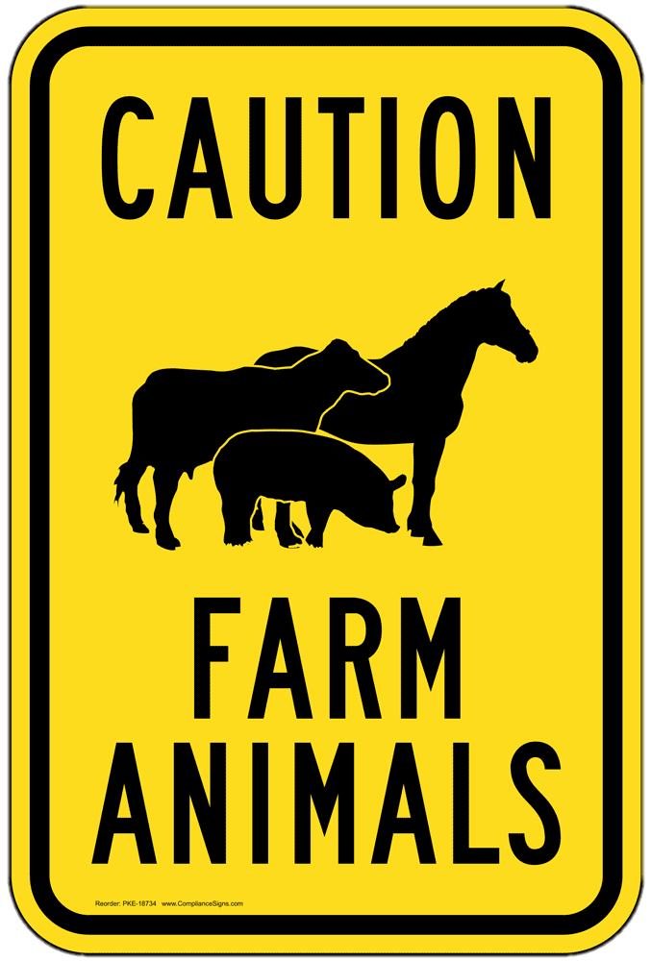
Hazards to animals
Foreign Objects
Metal objects such as jewelry
Plastic objects such as trash
Dangerous Foods
Excess sugar such as ice cream and candy
Foreign or uncooked food
Injury
Disease
Notes:
Uncooked or properly prepared food from other countries that visitors could theoretically bring in.
People or children may not know how to properly handle animals.

Slide 8
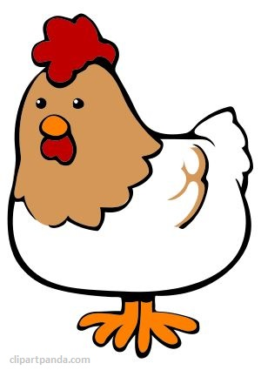
Hazards to animals – Disease Risk
COUGH
Avian and Swine Flu
Risk of animals contracting flu virus from ill visitors
Porcine Epidemic Diarrhea (PED)
Public may have pigs at home, wear same clothing/footwear
While not as likely, always have to be concerned about diseases we don’t have in this country (i.e. Foreign Animal Diseases)
Foot-and-Mouth Disease, African Swine Fever, Classical Swine Fever, Highly Pathogenic Avian Influenza
International travelers
Notes:
Never know where a visitor has gone recently. What goats they have snuggled. Where those shoes have been.

Slide 9
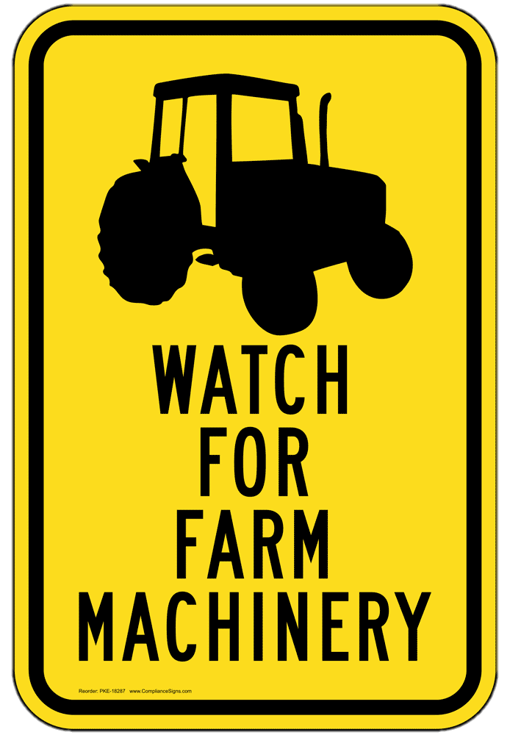
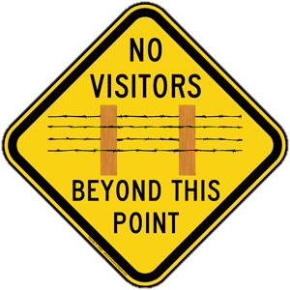
Hazards to People
Physical Injury
Animals
Bite, Kick, Scratch, Spitting
Environment
Equipment
Pathogen Exposure
Direct animal contact
E. coli, Salmonella, Orf, Ringworm, Rabies
Indirect contact
Contaminated food products, fences
Notes:
As friendly as an animal is, anything can happen.
Teenager died after thrown off a hayride, in ME, in 2014
All it takes is touching a contaminated pole, or bringing it home on their shoes.

Slide 10
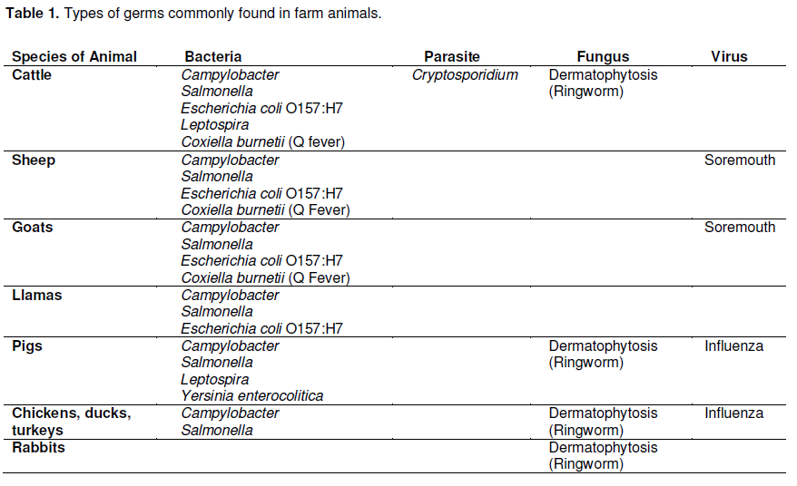
Safe Interactions with Animals at Your Agritourism Business – Minnesota Department of Health

Slide 11
“My Animals Look Healthy”
Doesn’t mean they are free of concern
Healthy-looking animals can still make people sick!
Safe Interactions with Animals at Your Agritourism Business – Minnesota Department of Health

Slide 12
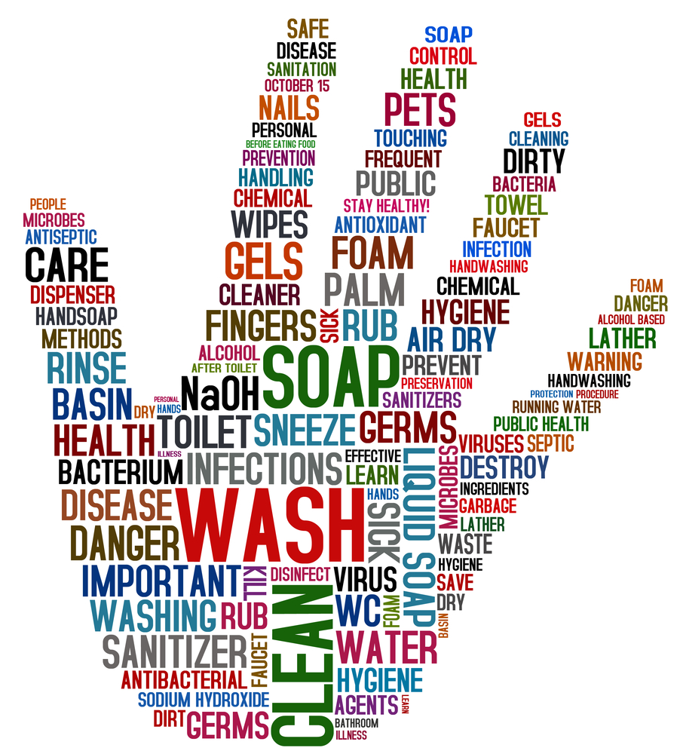
What Steps can be taken?
Limit Exposure
Limit Spread
Keep it Clean
Animal AND public areas
Protect the Fair

Slide 13
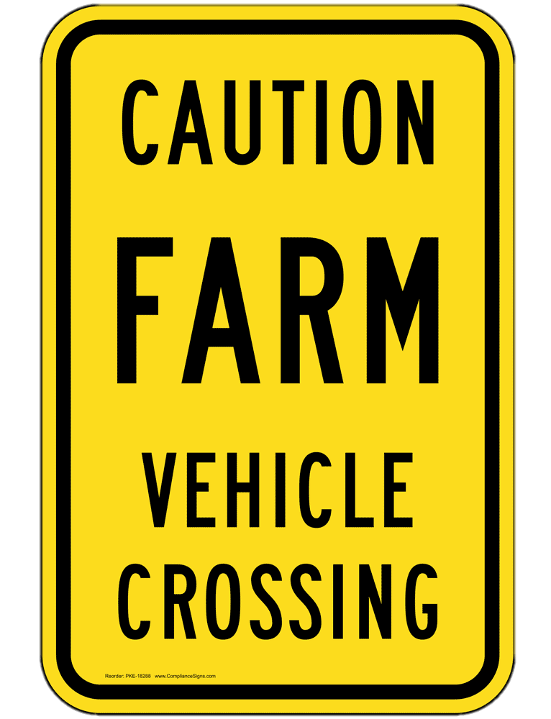
Limit exposure – what to avoid
Recommendations:
Don’t allow visitors to go unattended
Don’t allow visitors near sick or aggressive animals
Don’t allow visitors to come in contact with newborn animals or animals in labor
Don’t allow food or drink near animals

Slide 14
Limit spread – ways to set up
Animal health principles to follow:
Assess animals everyday for health and suitability for public contact
Appropriate vaccination and treatment protocols
Consult a veterinarian!
Animal ID tags and records
Visitor sign-in at entry – good time to inform high risk visitors

Slide 15
Ways to set up – High Risk Visitors
Children under 5 years, seniors, those with weakened immune systems, and pregnant women are at highest risk for disease
Educate and communicate the risks
Consider not allowing small children to hand feed
Consider having someone to talk about risks and safety at entry to animal area
Importance of training employees!
Notes:
3 year old got into that enclosure by crawling through a 3ft railing

Slide 16
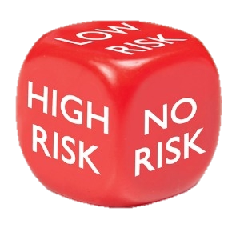
Ways to Minimize Risk
Many resources available to learn the risks and assess the operation or fair
Need to understand priorities and make improvements
Doesn’t need to cost a lot!
Many simple improvements that can make a big impact
Biosecurity!

Slide 17
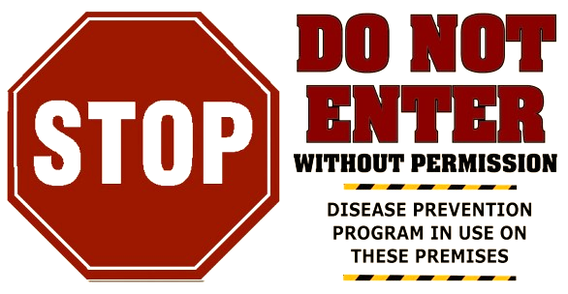
Why is biosecurity important?
Biosecurity’s goal is to:
Reduce infectious disease introduction and to minimize disease spread between animals on the farm
Protects:
Animals
People
The Farm
Biosecurity Risk Assessment for Farm Visitors and Exhibitions. Penn State Extension, 2016.

Slide 18
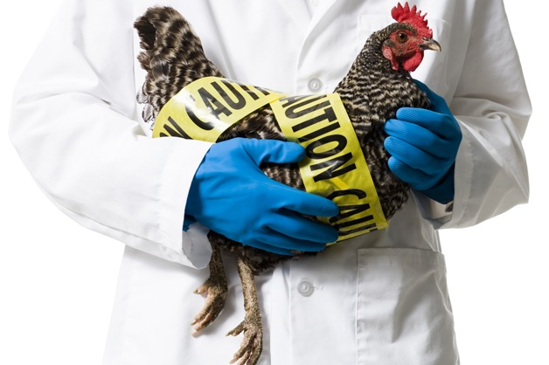
Biosecurity
Daily routine of reducing disease introduction and reducing disease spread amongst your animals
Common sense practices to prevent:
Introduction from multiple sources
People, vehicles, equipment, other animals
People from getting sick too!
Make it happen every day!
Notes:
Biosecurity tips are not just for HPAI.

Slide 19
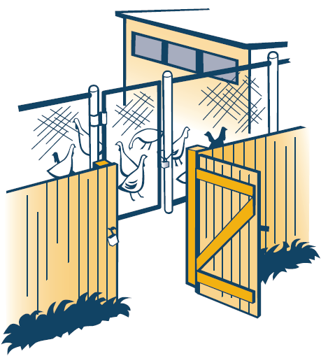
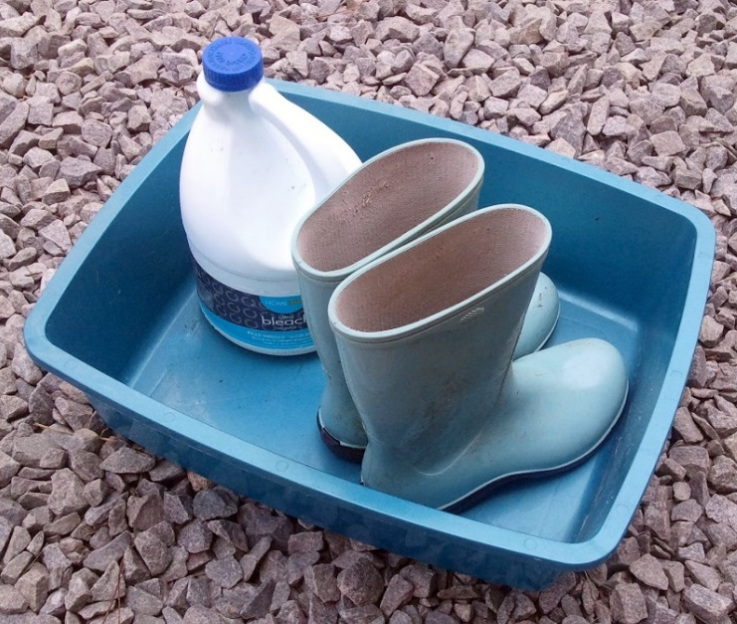
Biosecurity – Key Components
Controlling access to the animals
Enclosure boundaries, access points
Minimizes risk of disease introduction!
Visitor Records: Knowing who was on your farm when
Footbaths, Personal Protective Equipment (PPE)
Prevents spread of disease, protects the visitor
Dedicated clothes/footwear for your animals
For visitors:
Provide shoe covers or go through footbath

Slide 20
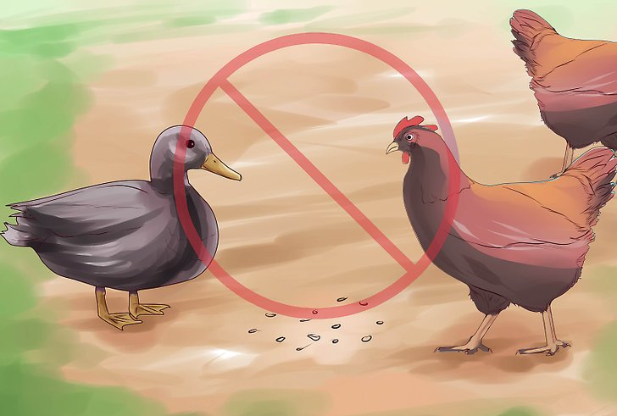
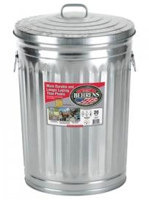
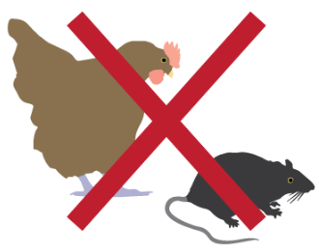
Biosecurity – Key Components
Feed and water sources
Free feed on the ground outside can attract other birds
Water from sources like a nearby pond where waterfowl visit
Pest control
Songbirds and rodents can carry disease
Can risk bringing disease to your flock

Slide 21
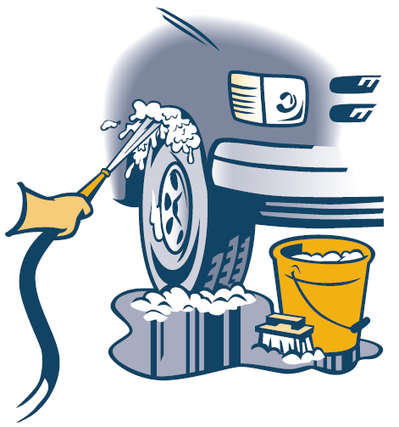
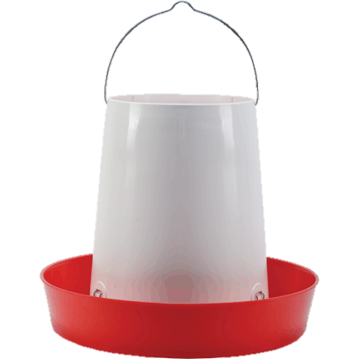
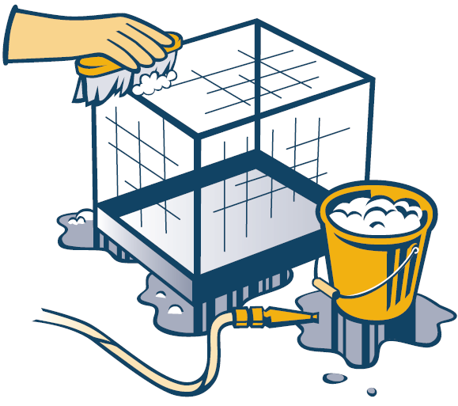
Biosecurity – Key Components
Cleaning & Disinfection (C&D)
Everything from vehicles to equipment to animal facilities
Remove ALL dirt and organic debris
Rinse thoroughly
Some will get deactivated by remaining soap residue!
Ensure proper contact time

Slide 22
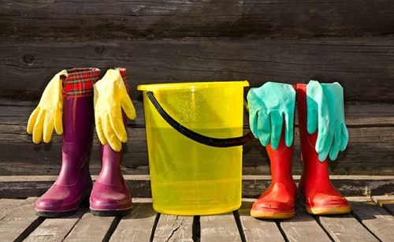
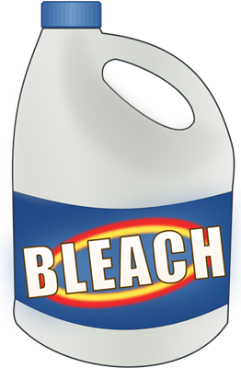
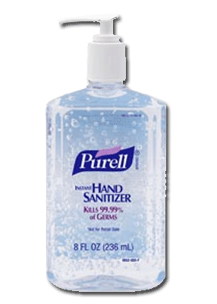
What Disinfectants Can I Use?
Roccal
Ok for some bacteria, viruses
Inactivated by organic matter, hard water, soap residue!
Virkon-S
Great for many bacteria, viruses, some fungi
Household bleach (sodium hypochlorite 6%):
Great for many bacteria, viruses, fungi
Inactivated by organic matter, soap residue, sunlight!
Purell hand sanitizer for hand disinfection
Lysol spray for footwear
Notes:
Over 200 commercially available products are registered as effective for killing influenza A (with EPA). Be careful with organic material that can de-activate disinfectant. We use Virkon. See backyard biosecurity hand-outs or website.

Slide 23
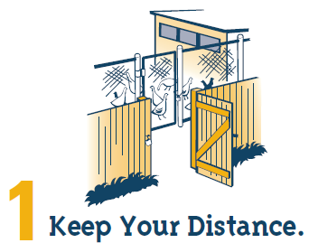
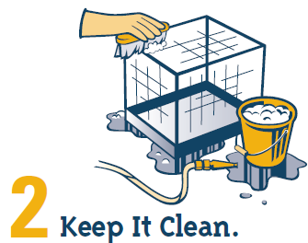
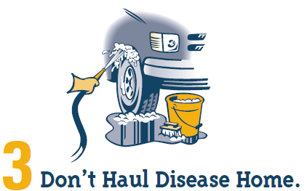
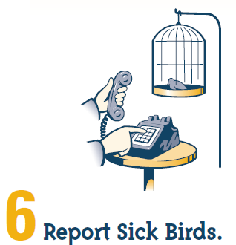
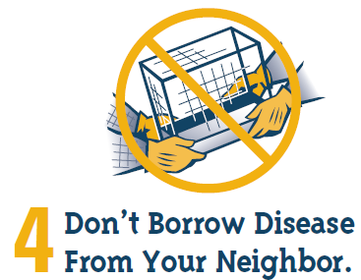
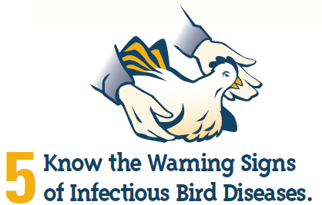
Six Steps to Remember

Slide 24
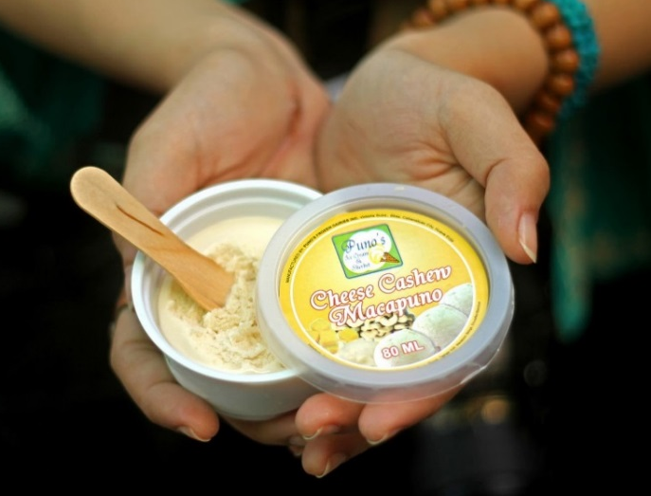
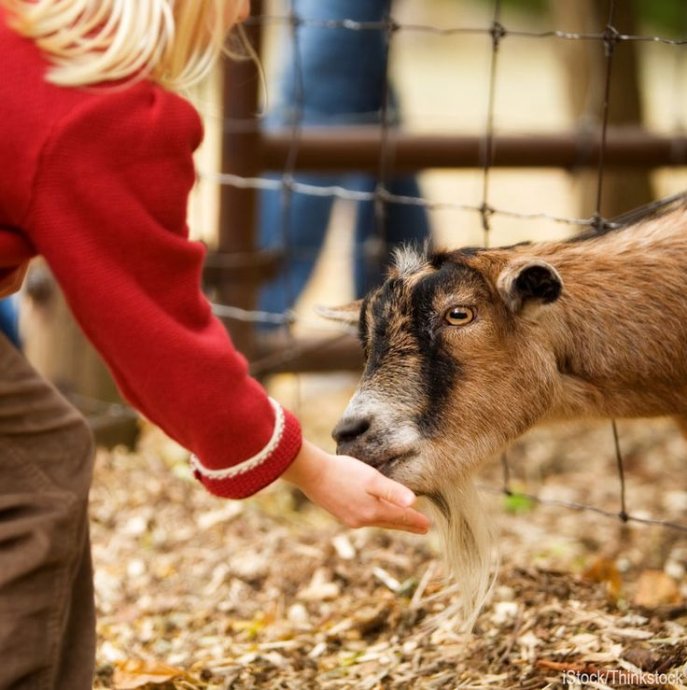
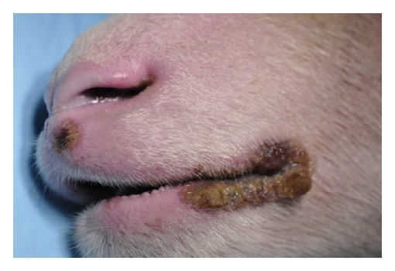
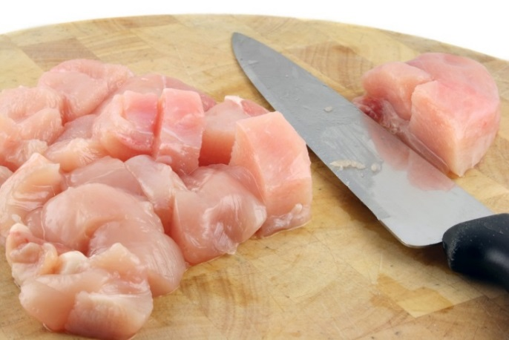
Biosecurity – Keeping People Safe!
Zoonotic Disease = A disease from animals that can pass to humans and make them sick
Examples:
Rabies
Salmonella
Orf
Avian Influenza
Can pass through direct contact, indirect contact, or foodborne

Slide 25
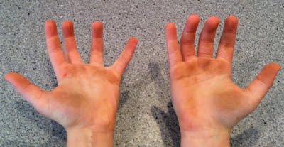
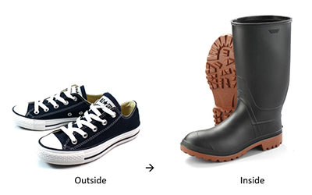
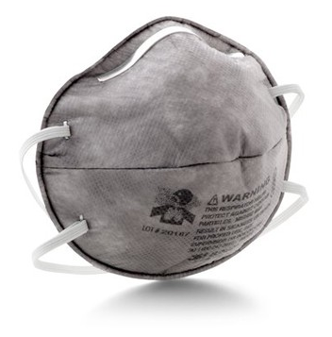
Zoonotic Disease Prevention
Handle yourself just like you handle your animals!
Washing after handling
Have dedicated equipment (shoes, clothing)
Wear protective equipment when necessary (ex. cleaning activities)

Slide 26
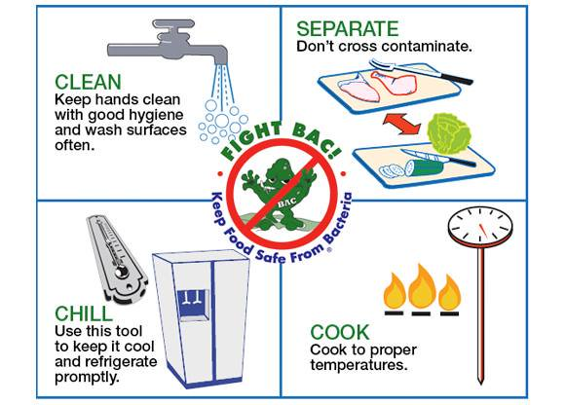
Zoonotic Disease Prevention

Slide 27
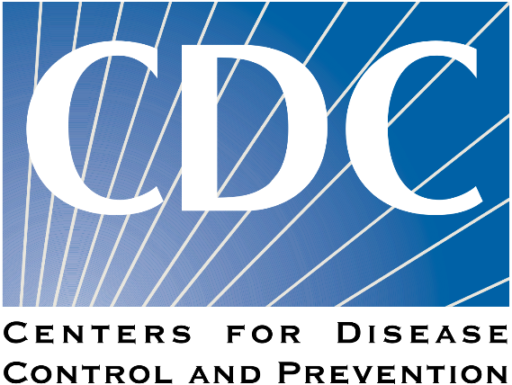
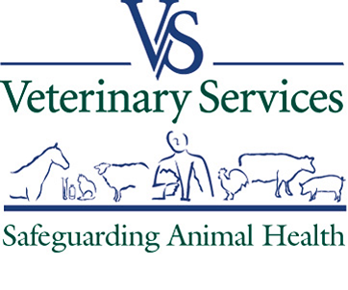
Federal VS. state involvement
As a Federal agency, what role do we play?
Public health disease outbreak prevention
Working with federal and state public health colleagues
No direct regulations for VS
Responsible for “safeguarding animal health”
Protecting agriculture in New England – “non-traditional systems”

Slide 28
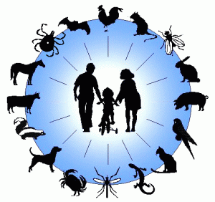
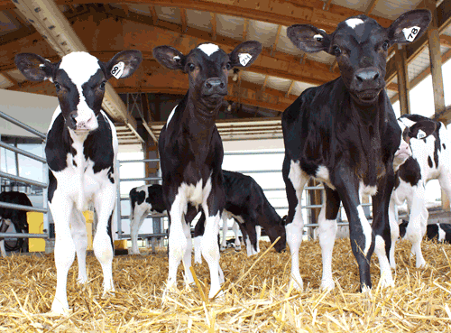
All About the Education
Educating yourself and educating your visitors
Animal Health
Public Health
Farm Health

Slide 29
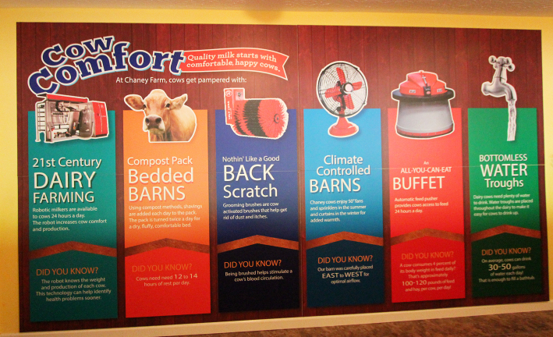
All About the Education
Agritourism provides education to the public that they would get nowhere else!
Animal husbandry
Animal welfare
Modern-day agricultural practices
Dedicated farmers =
Healthy animals
Healthy products
Happy consumers!

